Slide 1

Java EE:
JavaServer Faces
SoftUni Team
Technical Trainers
Software University
http://softuni.bg

Slide 2
Table of Contents
Model-View-Controller(MVC)
JavaServer Faces
Architecture
Managed Beans

Slide 3
Questions
sli.do #java-web

Slide 4

Model-View-Controller
Overview

Slide 5

What is Model-View-Controller?(1)
MVC:
Design pattern
Uses three separate modules:
Model - carries data
View - shows user interface
Controller - handles processing
of an application

Slide 6
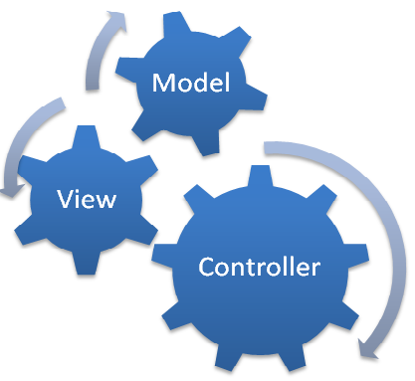
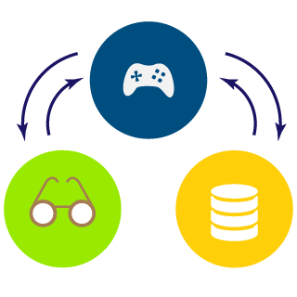
What is Model-View-Controller?(2)
Purpose of MVC design pattern:
To separate model and presentation
Web designers have to concentrate only on view layer
Developers - on model and controller layer

Slide 7

JavaServer Faces
Overview

Slide 8

What are JavaServer Faces?(1)
JavaServer Faces (JSF):
Java-based web application framework
Intended to simplify development integration of web-based
user interfaces
Standardized display technology
Formalized in a specification through the Java Community
Process:
https://jcp.org/en/jsr/detail?id=372

Slide 9

What are JavaServer Faces?(2)
JavaServer Faces (JSF):
MVC web framework
Simplifies the construction of User Interfaces (UI) for
server-based applications
Uses reusable UI components in a page
Provides a facility to connect UI widgets:
With data sources
Server-side event handlers

Slide 10
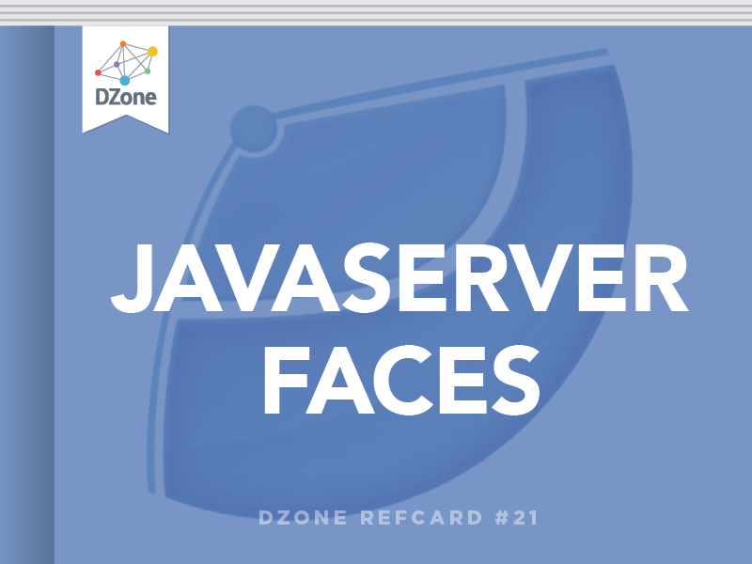
What are JavaServer Faces?(3)
The JSF specification defines:
Set of standard UI components
Provides an Application Programming Interface (API) for
developing components
JSF enables:
Reuse of UI components
Extension of the existing
standard UI components

Slide 11
What are JavaServer Faces?(4)
JSF reduces the effort in:
creating applications
maintaining applications
JSF facilitates Web application development by:
Providing reusable UI components
Making easy data transfer between UI components
Managing UI state across multiple server requests
Enabling implementation of custom components
Wiring client-side event to server-side application code

Slide 12


What are JavaServer Faces?(5)
JSF provides the developers with the capability to create Web application from collections of UI components that can render themselves in different ways for multiple client types:
HTML browser.
Wireless device.
WAP device.

Slide 13

What are JavaServer Faces?(6)
JSF provides:
Core library.
A set of base UI components - standard HTML input elements.
Extension of the base UI components to create additional UI component libraries or to extend existing components.
Multiple rendering capabilities that enable JSF UI components to render themselves differently depending on the client types.

Slide 14
JSF Architecture(1)
JSF application is:
Similar to any other Java technology-based web application
Runs in a Java servlet container
Contains:
JavaBeans components as models containing
application-specific functionality and data
A custom tag library for:
Representing event handlers and validators
Rendering UI components

Slide 15

JSF Architecture(2)
JSF application also contains:
UI components represented as stateful objects on the server
Server-side helper classes
Validators, event handlers, and navigation handlers
Application configuration resource file for configuring application resources

Slide 16

Managed Beans

Slide 17

Managed Beans
Managed Bean:
Regular Java Bean class registered with JSF
Managed by JSF framework
Contains:
Getter and setter methods
Business logic
Backing bean - a bean that contains all the HTML form values
Works as Model for UI component
Can be accessed from JSF page

Slide 18


JSF and Managed Beans
Examples

Slide 19
Hello World!(1)
web.xml
<?xml version = "1.0" encoding = "UTF-8"?>
<web-app xmlns:xsi="http://www.w3.org/2001/XMLSchema-instance"
xmlns="http://java.sun.com/xml/ns/javaee"
xmlns:web="http://java.sun.com/xml/ns/javaee/web-app_2_5.xsd"
xsi:schemaLocation="http://java.sun.com/xml/ns/javaee
http://java.sun.com/xml/ns/javaee/web-app_2_5.xsd"
id="WebApp_ID" version="2.5">
<welcome-file-list>
<welcome-file>faces/index.xhtml</welcome-file>
</welcome-file-list>
<servlet>
<servlet-name>Faces Servlet</servlet-name>
<servlet-class>javax.faces.webapp.FacesServlet</servlet-class>
<load-on-startup>1</load-on-startup>
</servlet>
…

Slide 20
Hello World!(2)
web.xml
…
<servlet-mapping>
<servlet-name>Faces Servlet</servlet-name>
<url-pattern>*.xhtml</url-pattern>
</servlet-mapping>
<servlet-mapping>
<servlet-name>Faces Servlet</servlet-name>
<url-pattern>*.jsf</url-pattern>
</servlet-mapping>
<servlet-mapping>
<servlet-name>Faces Servlet</servlet-name>
<url-pattern>*.faces</url-pattern>
</servlet-mapping>
<servlet-mapping>
<servlet-name>Faces Servlet</servlet-name>
<url-pattern>/faces/*</url-pattern>
</servlet-mapping>
</web-app>

Slide 21
Hello World!(3)
HelloWorldBean.java
@Named
@RequestScoped
public class HelloWorld implements Serializable {
private String message;
public HelloWorld() {
this.message = "Hello World!";
}
public String getMessage() {
return this.message;
}
public void setMessage(String message) {
this.message = message;
}
}

Slide 22
Hello World!(4)
index.xhtml
<?xml version="1.0" encoding="UTF-8"?>
<!DOCTYPE html
PUBLIC "-//W3C//DTD XHTML 1.0 Transitional//EN"
"http://www.w3.org/TR/xhtml1/DTD/xhtml1-transitional.dtd">
<html xmlns="http://www.w3.org/1999/xhtml"
xmlns:h="http://java.sun.com/jsf/html">
<h:head>
<title>JSF Demo</title>
</h:head>
<h:body>
<h1>#{helloWorld.message}</h1>
</h:body>
</html>

Slide 23
Register Users!(1)
RegisterUserBean.java
@Named
@RequestScoped
public class UserRegisterBean {
private String username;
private String password;
private final UserRepository userRepository;
@Inject
public UserRegisterBean(UserRepository userRepository) {
this.userRepository = userRepository;
}
// Getters and Setters
public void register() {
User user = new User(this.username, this.password);
this.userRepository.save(user);
}
}

Slide 24
Register Users!(2)
index.xhtml
<?xml version="1.0" encoding="UTF-8"?>
<!DOCTYPE html
PUBLIC "-//W3C//DTD XHTML 1.0 Transitional//EN"
"http://www.w3.org/TR/xhtml1/DTD/xhtml1-transitional.dtd">
<html xmlns="http://www.w3.org/1999/xhtml"
xmlns:h="http://java.sun.com/jsf/html">
<h:head>
<title>JSF Demo</title>
</h:head>
<h:body>
<label for="usernameInput" />
<h:outputText id="usernameInput" value="#{userRegisterBean.username}"/>
<label for="passwordInput" />
<input type="password" id="passwordInput" jsfc="h:inputSecret" value="#{userRegisterBean.password}" />
<h:commandButton value="Register" action="#{userRegisterBean.register}"/>
</h:body>
</html>

Slide 25

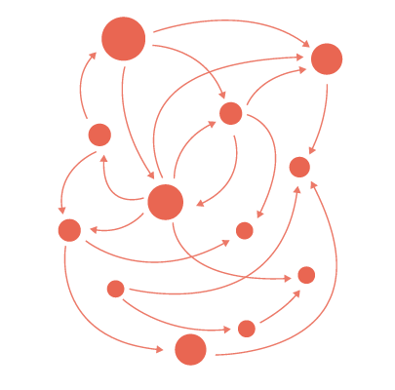


Summary
MVC:
Model
View
Controller
JavaServer Faces:
MVC web framework
Managed Beans:
Java bean managed by JSF framework

Slide 26
https://softuni.bg/trainings/courses

Slide 27













SoftUni Diamond Partners

Slide 28




SoftUni Organizational Partners

Slide 29




Trainings @ Software University (SoftUni)
Software University – High-Quality Education and Employment Opportunities
softuni.bg
Software University Foundation
http://softuni.foundation/
Software University @ Facebook
facebook.com/SoftwareUniversity
Software University Forums
forum.softuni.bg

Slide 30

License
This course (slides, examples, demos, videos, homework, etc.) is licensed under the "Creative Commons Attribution-NonCommercial-ShareAlike 4.0 International" license

